Slide 1
CSE 299
Project Name: Find a Doc
Section: 4
Group: 5
Group Members:
Arshi Siddiqui Promiti- 1611236042
Mousfiqul Islam Khan- 1521402642
Arafat Hossain- 1521601042

Slide 2
Feature List
Login/Logout:
Users will be able to register with their details(name, phone number) and look for doctors. Doctors will be able to register and provide their necessary information, for instance, name, their respective medical degrees, their practicing chamber address or the hospital name and address. Once they verify about their degree, there will be a sign(a half moon) beside their name in their profile.

Slide 3
Feature List
Set Appointments:
Once logged in, the user can set an appointment with their preferred doctor, or with a suggested doctor. User can search for a doctor by the doctor’s name or they can search for a specialized field, for example, medicine or cardiology, and then choose from the list of doctors that appears as the search result. The user can then set an appointment on their preferred time with the doctor.

Slide 4
Feature List
Symptom Checker:
Registered users can log in, and input their symptoms. The user can tick on the box next to each symptom on the list of symptoms and if a symptom is not listed, then the user can tick on “others” and specify the symptom they are experiencing. The symptom will then be matched with a disease and the user will be referred to doctors of the specialization according to the symptoms. For example, if someone experiences chest pain, high blood pressure, severe headache, irregular heartbeat etc, he/she will be referred to a list of cardiologists with their ratings.

Slide 5
Feature List
Rate/Review Doctors:
Users can login and give reviews about doctors after consultation. The users will be able to rate and also write a short review on the doctor they consulted. Users can rate a doctor with 1 to 5 stars and write a short review explaining their choice, for instance, if a patient had to experience long waiting hours and wrong treatment from a doctor, then the patient can rate and write a review on how he/she received a wrong treatment. Others can see the reviews and the ratings will be used to create a doctor ranking for each specialization.

Slide 6
Feature List
Manage Appointments:
Doctors can provide a list of timings during which they are willing to take appointments of patients. Users can see the timings available for a particular doctor and pick their suitable timings accordingly.

Slide 7
Work Division:
Arshi Siddiqui Promiti - Documentation and database
Mousfiqul Islam Khan - Functionalities and logic
Arafat Hossain - Web Design

Slide 8
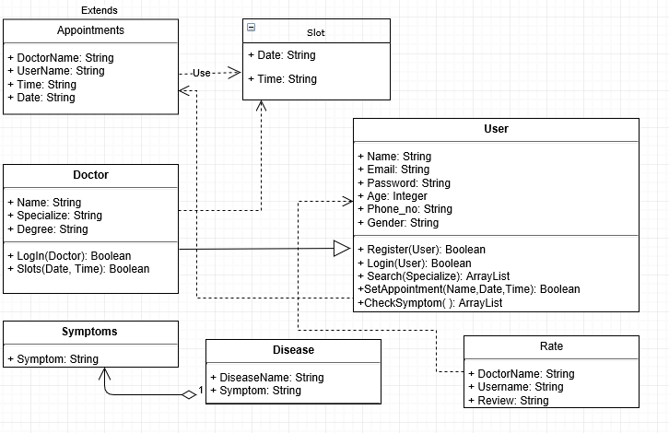
UML Diagram

